Slide 1
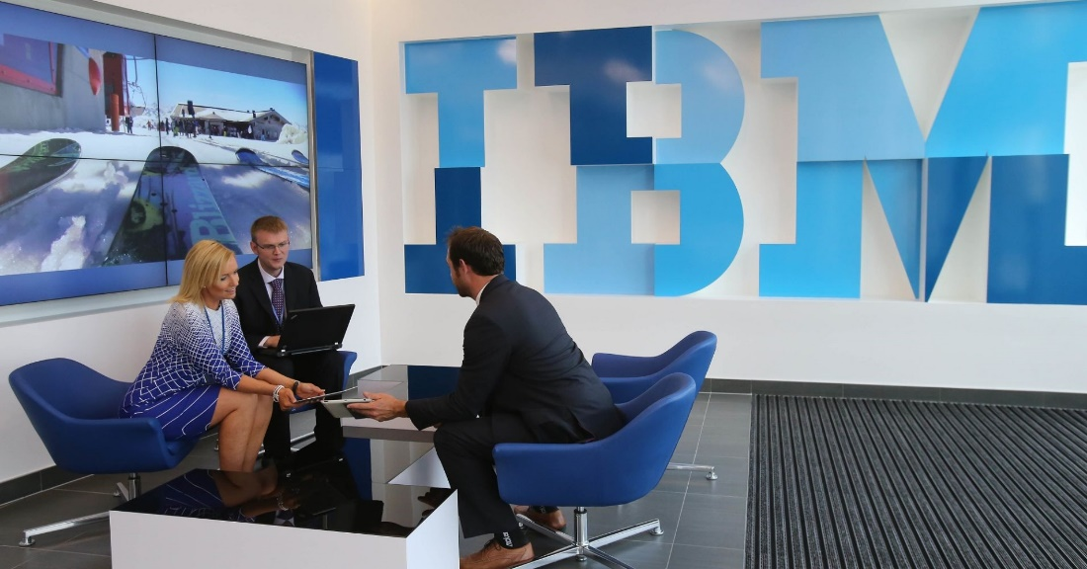
IBM Attrition Analysis
Apurva Sharma
Shaojie Zhang
Jiaming Guo
Srinivas Reddy Pachika
Wenqi Wu
1

Slide 2





Introduction
Data Description & Visualization
Conclusion
Predicting Variables
Modeling Analysis
Agenda

Slide 3
01
Introduction
3

Slide 4





Introduction
American MNC
Worried HR department!
IBM Profile
4

Slide 5
02
Description & Visualization
5

Slide 6
Description & Visualization
Data Overview
Source
https://www.kaggle.com/pavansubhasht/ibm-hr-analytics-attrition-dataset/home
Objective
Total include 35 variables and 1470 observations
Sample
a random sample out of the total IBM employees within 3 departments for the previous year this data was collected.
6

Slide 7
Description & Visualization
Data Dictionary
Variable | Meaning | Levels
Age | Age of the employee
Attrition | Whether the employee left in the previous year or not
BusinessTravel | How frequently the employees travelled for business purposes in the last year
Department | Department in company
DistanceFromHome | Distance from home in kms
Education | Education Level | 1 'Below College'
 |  | 2 'College'
 |  | 3 'Bachelor'
 |  | 4 'Master'
 |  | 5 'Doctor'
EducationField | Field of education
EmployeeCount | Employee count
EmployeeNumber | Employee number/id
EnvironmentSatisfaction | Work Environment Satisfaction Level | 1 'Low'
 |  | 2 'Medium'
 |  | 3 'High'
 |  | 4 'Very High'
Gender | Gender of employee
JobInvolvement | Job Involvement Level | 1 'Low'
 |  | 2 'Medium'
 |  | 3 'High'
 |  | 4 'Very High'
JobLevel | Job level at company on a scale of 1 to 5
JobRole | Name of job role in company
Variable | Meaning | Levels
JobSatisfaction | Job Satisfaction Level | 1 'Low'
 |  | 2 'Medium'
 |  | 3 'High'
 |  | 4 'Very High'
MaritalStatus | Marital status of the employee
MonthlyIncome | Monthly income in rupees per month
NumCompaniesWorked | Total number of companies the employee has worked for
Over18 | Whether the employee is above 18 years of age or not
PercentSalaryHike | Percent salary hike for last year
PerformanceRating | Performance rating for last year | 1 'Low'
 |  | 2 'Good'
 |  | 3 'Excellent'
 |  | 4 'Outstanding'
RelationshipSatisfaction | Relationship satisfaction level | 1 'Low'
 |  | 2 'Medium'
 |  | 3 'High'
 |  | 4 'Very High'
StandardHours | Standard hours of work for the employee
StockOptionLevel | Stock option level of the employee
TotalWorkingYears | Total number of years the employee has worked so far
TrainingTimesLastYear | Number of times training was conducted for this employee last year
WorkLifeBalance | Work life balance level | 1 'Bad'
 |  | 2 'Good'
 |  | 3 'Better'
 |  | 4 'Best'
YearsAtCompany | Total number of years spent at the company by the employee
YearsSinceLastPromotion | Number of years since last promotion
YearsWithCurrManager | Number of years under current manager
7

Slide 8
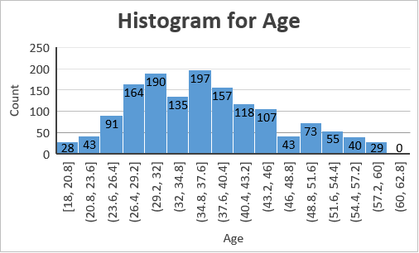
Description & Visualization
Data Visualization
1. Employee Profile
Employee age distribution
Male>Female
84% Employees choose to stay in IBM
8

Slide 9
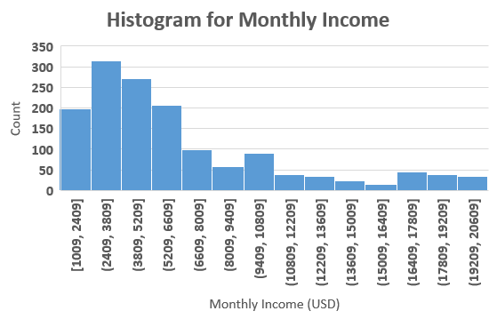
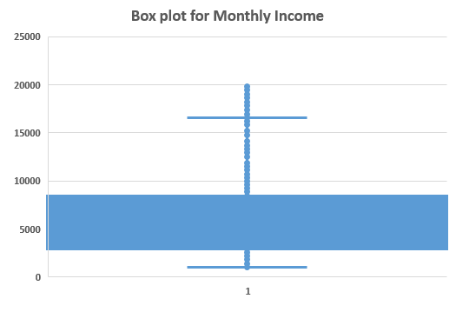
Description & Visualization
Data Visualization
2. Monthly Income
2500-8000 USD
Right Skewed
9

Slide 10
Description & Visualization
Data Visualization
3. Cross Group Comparison
23%
Yes: 31%
Attrition Rate
Attrition Rate
16%
17%
11%
No: 10%
Satisfaction
10
Cross Group Bar Chart

Slide 11
Description & Visualization
Winsorization
Z Score
99% Winsorization
11

Slide 12
Description & Visualization
Data Cleaning
No NA’s , Drop columns (EmployeeNumber,EmployeeCount,StandardHours,Over18 etc.)
Correlation
99% Winsorization on these columns
Age
Monthly Income
Years with Current Manager
Total Working Years
Years at Company
Distance from Company
Years Since Last Promotion
12

Slide 13
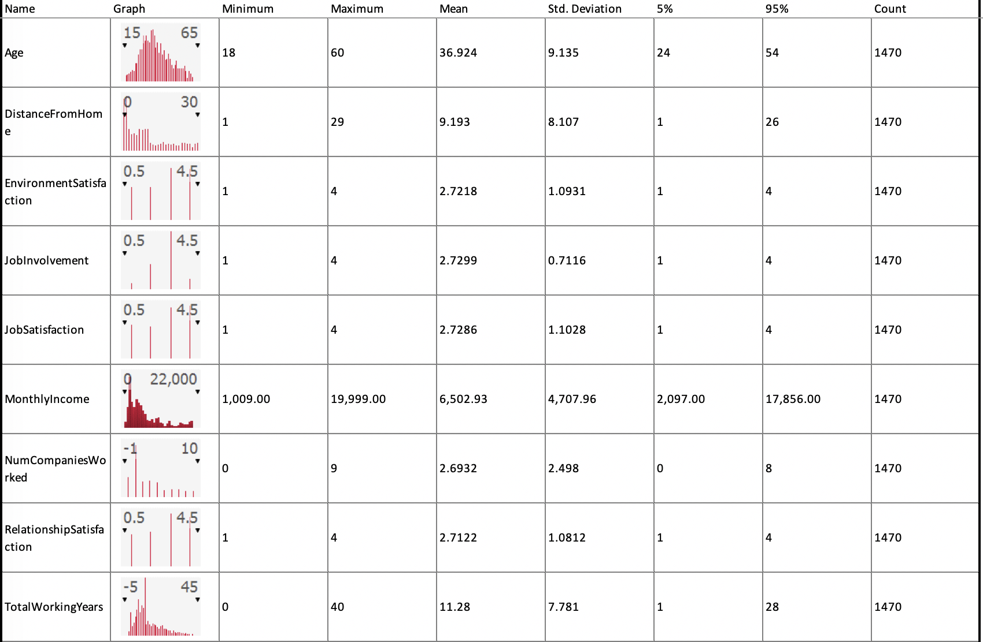
Description & Visualization
Data Summary
After data cleansing
1470 data points
13

Slide 14
Conclusion
Better understanding of the data
Import factors
14

Slide 15
Analysis of Association Between Variables
Study the correlation and the relationship between variables.
Build model to predict the attrition, and explore interesting and important factors
Derive useful business insights, and predict the attrition.
15

Slide 16
03
Predicting Variables
● Dependent Variables
● Reasons
● Scatter Plots
● Correlation
16

Slide 17
Predicting Variables
Dependent Variables and Reasons
Department
Job Level
Monthly Income
Job Role
Total Working Yrs
Yrs Since Last Promotion
Yrs with Manager
Environment Satisfaction
Education
Overtime
Attrition
Yrs in Current Role
Job Satisfaction
Marital Status
Business Travel
17

Slide 18
Predicting Variables
Scatter Plots
1
2
3
18

Slide 19
Predicting Variables
Scatter Plots
19

Slide 20
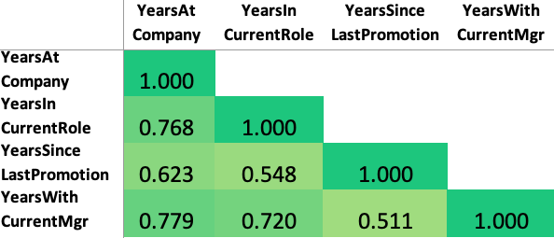
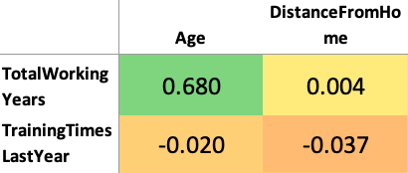
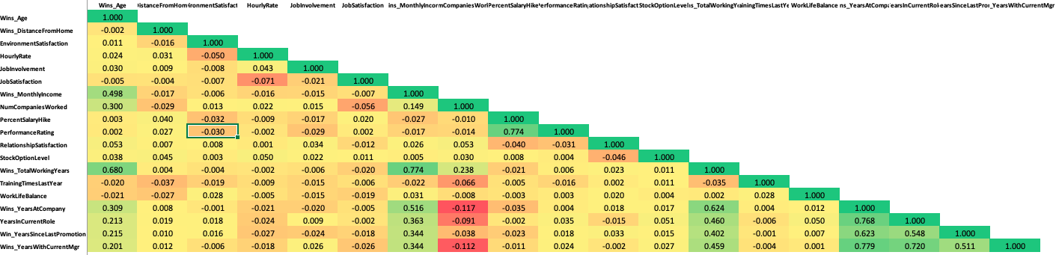
Predicting Variables
Correlation
20

Slide 21
04
Modeling Analysis
21

Slide 22
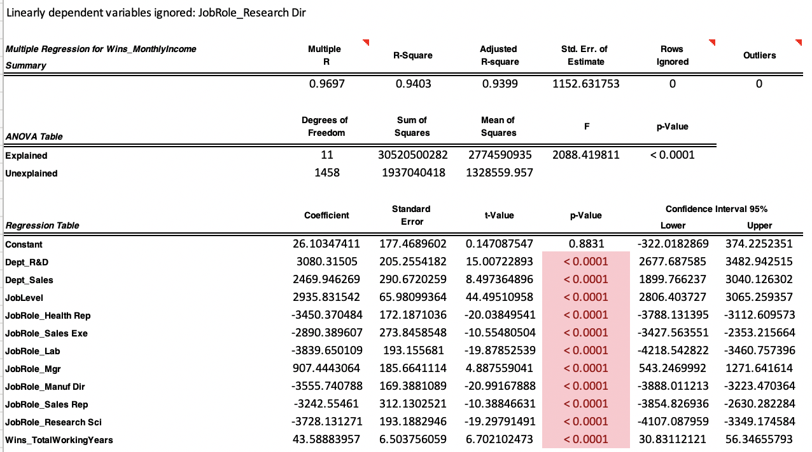
Modeling Analysis
Linear Analysis
Only keep the significant variables
R square: 0.9399
P-Value: <0.0001
Significant Variables:
Department
Job Level
Job Role
Total working years
22

Slide 23
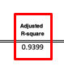
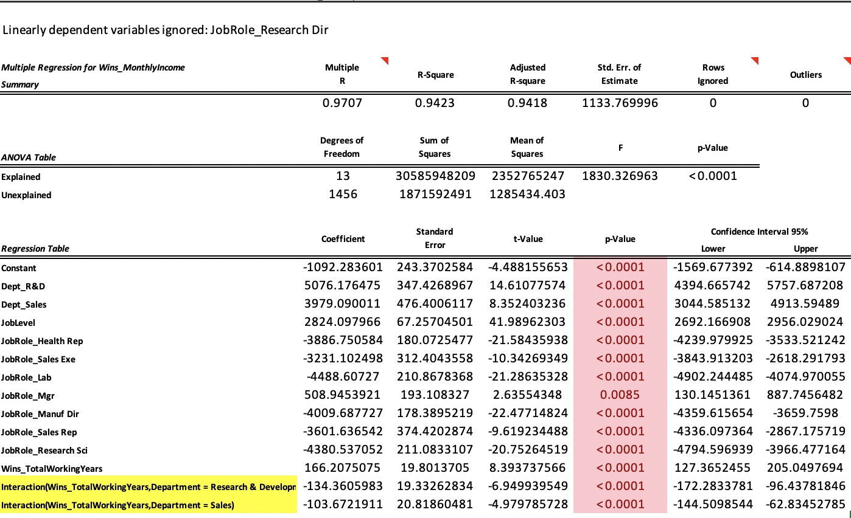
Modeling Analysis
Linear Analysis with interaction variables
Only keep the significant variables
R square: 0.9418
P Value: <0.0001
Interaction Variables:
Total Working Year * Department
Previous R square (0.9399)
23

Slide 24
Modeling Analysis
Interpretation on coefficients
Department: | R&D
Job Role: | Manager
Job Level: | 3
Department: | Sales
Job Role: | Manager
Job Level: | 3
Department: | Sales
Job Role: | Manager
Job Level: | 4
-1092.28+
5076.18* R&D Department+
2824.09* JobLevel(3)+
508.94* JobRole_Mgr+
-134.36* TotalWorkingYear* R&D
= 12830.77
-1092.28+
3979.09* Sales Department+
2824.09* JobLevel(3)+
508.94* JobRole_Mgr+
-103.67* TotalWorkingYear* Sale
= 11764.37
-1092.28+
3979.09* Sales Department+
2824.09* JobLevel(4)+
508.94* JobRole_Mgr+
-103.67* TotalWorkingYear* Sale
= 14588.47
24
Holding all other variables constant, every additional year of experience is predicted to increase HR department's employees' monthly income by 166.20 USD, but increase R&D employees’ monthly income 134.36 less than the HR department.
Keeping everything constant, a manager with job level 3 in Sales department is predicted to be paid 2824.01 USD more than a manager with job level 4 in Sales department.
Keeping everything constant, a manager with level 3 in R&D department earns 1066 USD more than a manager with level 3 in Sales department.

Slide 25

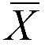


Modeling Analysis
Hypothesis Test
Assumption:
Population Mean ( ) = Sample Mean ( )
Hypothesis:
H0: 6300
Ha: > 6300
For:
 | Monthly Income
Hypothesis Test (One-Sample)
Sample Size | 1470
Sample Mean | 6502.93
Sample Std Dev | 4707.96
Hypothesized Mean | 6300
Alternative Hypothesis | > 6300
Standard Error of Mean | 122.79
Degrees of Freedom | 1469
t-Test Statistic | 1.6526
p-Value | 0.0493
Null Hypoth. at 10% Significance | Reject
Null Hypoth. at 5% Significance | Reject
Null Hypoth. at 1% Significance | Don't Reject
=5%
=1%
25

Slide 26
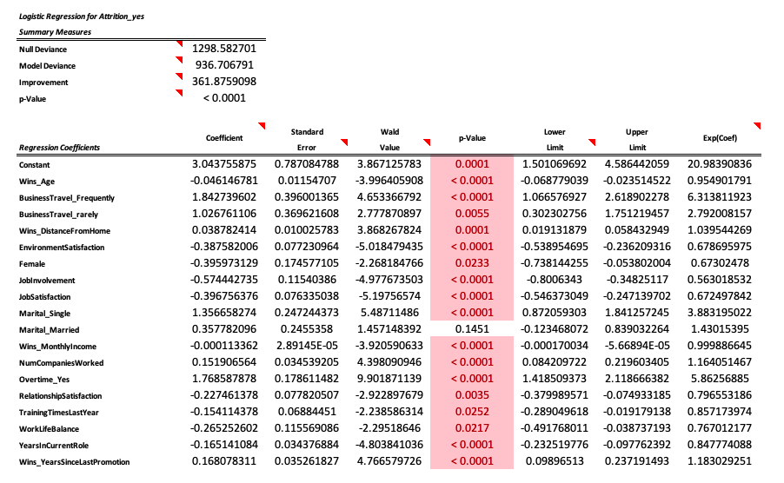
Modeling Analysis
Logistic Regression
P-Value: <0.0001
Significant Variables:
Age
Business Travel
Distance from Home
Environment Satisfaction
Gender
Job Involvement
Marital Status
Monthly Income
Number of Company Worked
Overtime
Relationship Satisfaction
Training Time Last Year
Work Life Balance
Years In Current Role
Years Since Last Promotion
26

Slide 27
Modeling Analysis
Interpretation on coefficients
Constant | Age | BusinessTravel_Frequently | BusinessTravel_rarely | DistanceFromHome | EnvironmentSatisfaction | Female
3.04 | -0.05 | 1.84 | 1.03 | 0.04 | -0.39 | -0.40
1 | 36 | 1 | 0 | 7 | 3 | 0
1 | 36 | 1 | 0 | 7 | 3 | 0
JobInvolvement | JobSatisfaction | Marital_Single | Marital_Married
-0.57 | -0.40 | 1.36 | 0.36
3 | 3 | 1 | 0
3 | 3 | 1 | 0
MonthlyIncome | NumCompaniesWorked | Overtime_Yes | RelationshipSatisfaction | TrainingTimesLastYear | WorkLifeBalance | YearsInCurrentRole | YearsSinceLastPromotion
0.00 | 0.15 | 1.77 | -0.23 | -0.15 | -0.27 | -0.17 | 0.17
4919 | 2 | 1 | 3 | 3 | 3 | 3 | 1
4919 | 2 | 0 | 3 | 3 | 3 | 3 | 1
Prediction
 | Ln(Z) | Z
 | P(Arrition=Yes)
Overtime=1 | 50.60% | 0.0239
Overtime=0 | 14.87% | -1.7446
 | 35.73%
27
Holding all other variables constant, every additional year of experience is predicted to increase HR department's employees' monthly income by 166.20 USD, but increase R&D employees’ monthly income 134.36 less than the HR department.
Keeping everything constant, a manager with job level 3 in Sales department is predicted to be paid 2824.01 USD more than a manager with job level 4 in Sales department.
Keeping everything constant, a manager with level 3 in R&D department earns 1066 USD more than a manager with level 3 in Sales department.

Slide 28
05
Conclusion
28

Slide 29
Conclusion
Who may benefit from our finding: Senior HR Management Department in IBM and other similar tech-companies
Business Insight
How to control the attrition rate
do not subject their employees to increased ‘overtime’ and ’business travel’
to retain their employees , since ‘monthly salary’ positively drives the attrition rate significantly , the company must consider the employees’ total work experience, their department
company must invest on their employees in terms of vocational trainings offered over the year and focus on their job involvement
If the employee has worked for a high number of companies in their past career, the employee might prefer to change their firm every few years and this might have nothing to do with IBM
29

